Slide 1
Software Development Project
AAPP006-4-2 & Version 1
Software Testing

Slide 2
Topic & Structure of The Lesson
Testing

Slide 3
Learning Outcomes
At the end of this topic, You should be able to
Create the plan for testing and perform the testing

Slide 4
Key Terms You Must Be Able To Use
If you have mastered this topic, you should be able to use the following terms correctly in your assignments and exams:
Testing

Slide 5
Software Testing
Software Testing is a method to check whether the actual software product matches expected requirements and to ensure that software product is defect free.
The purpose of software testing is to identify errors, gaps or missing requirements in contrast to actual requirements.

Slide 6
Benefits
Cost-Effective: Testing any IT project on time helps you to save your money for the long term. In case if the bugs caught in the earlier stage of software testing, it costs less to fix.
Security: People are looking for trusted products. It helps in removing risks and problems earlier.
Product quality: It is an essential requirement of any software product. Testing ensures a quality product is delivered to customers.
Customer Satisfaction: The main aim of any product is to give satisfaction to their customers. Ensures the best user experience.

Slide 7
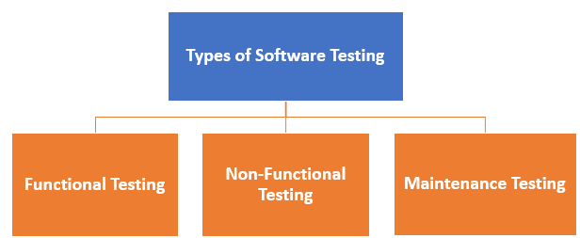
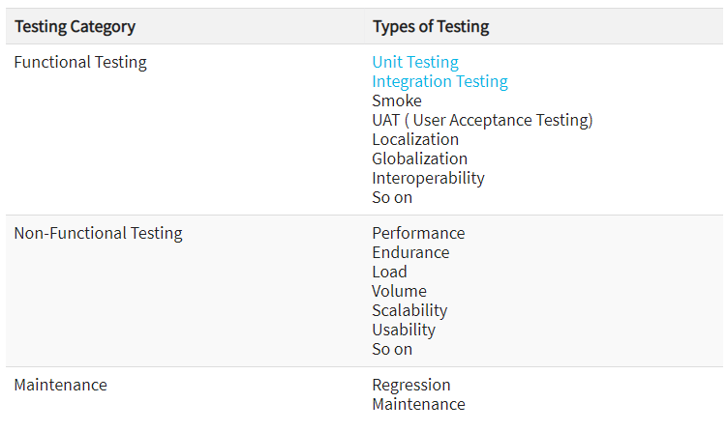
Types of Software Testing

Slide 8
Basic Software Testing
Unit Testing: This software testing approach is followed by the programmer to test the unit of the program. It helps developers to know whether the individual unit of the code is working properly or not.
Integration testing: It focuses on the construction and design of the software. You need to see that the integrated units are working without errors or not.
System testing: In this method, your software is compiled as a whole and then tested as a whole. This testing strategy checks the functionality, security, portability, amongst others.

Slide 9
Sample Test Plan (Unit Testing)
Test Case # | Test Unit | Test Procedures | Test Data | Expected Result | Actual Result | Status | Remarks
T023 | User Login | 1. Insert account email address. 2. Insert account password. 3. Click on “Login” button | Correct Input Data 1. Email Address: darrenseow9@gmail.com 2. Password: 121212 | Successfully Login into system.
 |  | 1. Insert account email address. 2. Insert account password. 3. Click on “Login” button | Incorrect Input Data 1. Email Address: darren_332@gmail.com 2. Password: elabilab2u | Unable to login into the system and the error message is expected to be output.
T024 | Account Registration | 1. Insert user’s name 2. Insert email address. 3. Insert password. 4. Insert confirm password. 5. Click on “Create Account” button. | Correct Input Data 1. Name*: Lionel Massi 2. Email Address*: massi111@hotmail.com 3. Password*: massi1Q23 (*) Represent required field | Successfully registered new account. A verification email is expected to send to user’s email service.
 |  | 1. Insert user’s name 2. Insert email address. 3. Insert password. 4. Insert confirm password. 5. Click on “Create Account” button. | Incorrect Input Data (Existing Email) 1. Name*: Lionel Massi 2. Email Address*: messi123@hotmail.com 3. Password*: massi1Q23 (*) Represent required field | Not successful registration due to the inserted email is belong to an account in the system. An error message will display to user and required user to insert a new email address.

Slide 10
Sample Test Plan (Unit Testing)
Test Case # | Test Unit | Test Procedures | Test Data | Expected Result | Actual Result | Status | Remarks
T023 | User Login | 1. Insert account email address. 2. Insert account password. 3. Click on “Login” button | Correct Input Data 1. Email Address: darrenseow9@gmail.com 2. Password: 121212 | Successfully Login into system. | Login is successful. | Success. | -
 |  | 1. Insert account email address. 2. Insert account password. 3. Click on “Login” button | Incorrect Input Data 1. Email Address: darren_332@gmail.com 2. Password: elabilab2u | Unable to login into the system and the error message is expected to be output. | Login failed and error message is displayed. | Success | -
T024 | Account Registration | 1. Insert user’s name 2. Insert email address. 3. Insert password. 4. Insert confirm password. 5. Click on “Create Account” button. | Correct Input Data 1. Name*: Lionel Massi 2. Email Address*: massi111@hotmail.com 3. Password*: massi1Q23 (*) Represent required field | Successfully registered new account. A verification email is expected to send to user’s email service. | New account is created without issue and verification email has been send. | Success | -
 |  | 1. Insert user’s name 2. Insert email address. 3. Insert password. 4. Insert confirm password. 5. Click on “Create Account” button. | Incorrect Input Data (Existing Email) 1. Name*: Lionel Massi 2. Email Address*: messi123@hotmail.com 3. Password*: massi1Q23 (*) Represent required field | Not successful registration due to the inserted email is belong to an account in the system. An error message will display to user and required user to insert a new email address. | Registration failed and error message is display. | Success | -

Slide 11
User Acceptance Testing
Is a type of testing performed by the end user or the client to verify/accept the software system before moving the software application to the production environment.
UAT is done in the final phase of testing after functional, integration and system testing is done.
They capture user requirements in a directly verifiable way and identify problems which unit or integration tests might have missed

Slide 12
Sample of UAT
Click here to see samples

Slide 13
Summary of Main Teaching Points
Every software need to go through the testing
There are many testing types but the basic testing are widely being used to test the software
there are more than 150 types of testing types and still adding. Also, note that not all testing types are applicable to all projects but depend on the nature & scope of the project.

Slide 14
Question and Answer Session
Q & A

Slide 15
What we will cover next
System Testing

